Slide 1

Diplomatura Ciencia de Datos
Módulo 4 - Big Data

Slide 2

Big Data?
“[...]We are in the middle of a revolution in the way data is stored and processed[...]”

Slide 3
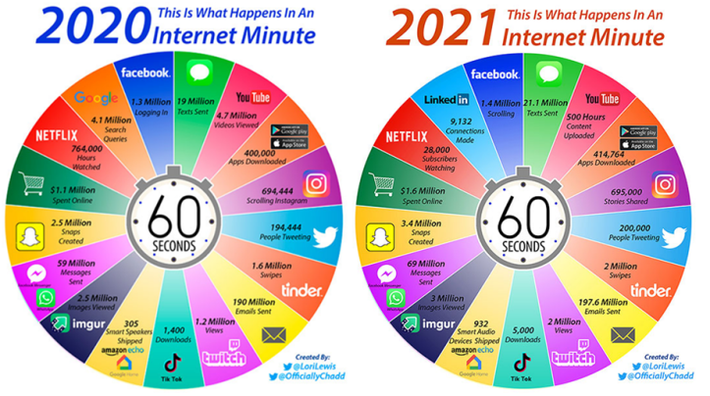
Contexto

Slide 4
The Data-Driven Economy is Emerging
g
Local Economies
Global Data Economies

Slide 5
Data-Driven
Cuando una empresa emplea un enfoque “data-driven” (impulsado por datos), significa que toma decisiones estratégicas basadas en análisis de datos e interpretación. Una compañía data-driven ha adaptado su cultura empresarial para manejarse en un entorno digitalizado basado en datos.

Slide 6
The Big Data Era
La era de Big Data comienza con MapReduce permitiendo cálculos paralelos en una gran cantidad de máquinas distribuidas.
[MapReduce paper, released by Google]
Notes:
Estas primitivas permitieron cálculos paralelos en una gran cantidad de máquinas paralelas. Obviamente, los cálculos paralelos eran posibles incluso antes de la era MapReduce a través de múltiples computadoras, supercomputadoras y sistemas MPI. Sin embargo, MapReduce lo puso a disposición de una audiencia más amplia.
MapReduce está pensado para la solución práctica de algunos problemas que pueden ser paralelizados, pero se ha de tener en cuenta que no todos los problemas pueden resolverse eficientemente con MapReduce. MapReduce está orientado a resolver problemas con conjuntos de datos de gran tamaño

Slide 7
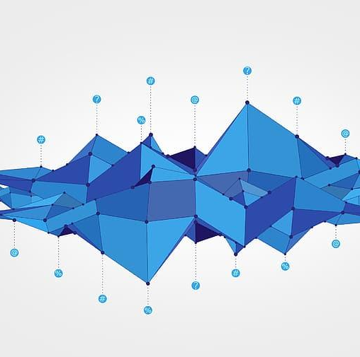
Tendencias
Se proyecta que el mercado de Big Data seguirá creciendo a un ritmo acelerado, alcanzando más de USD$300 mil millones para 2026.
Notes:
Los mercados relacionados, como el aprendizaje profundo y la inteligencia artificial, que están habilitados por las plataformas de datos, también experimentarán un crecimiento exponencial en la próxima década.

Slide 8

Definición e Historia

Slide 9
Big Data
3 Vs
Volumen
Variedad
Velocidad
5 Vs
Volumen
Variedad
Velocidad
Veracidad
Valor
7 Vs
Volumen
Variedad
Velocidad
Veracidad
Valor
Viabilidad
Visualización

Slide 10
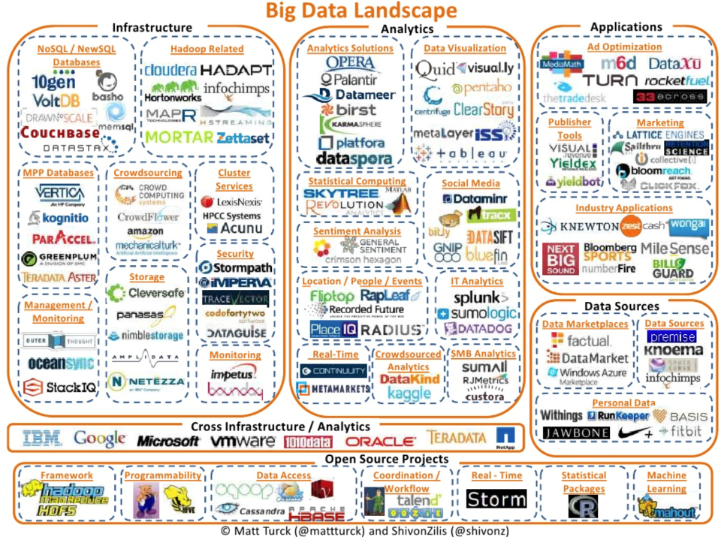
Landscape Completo Big Data 2012
Notes:
Lisa y los dientes

Slide 11
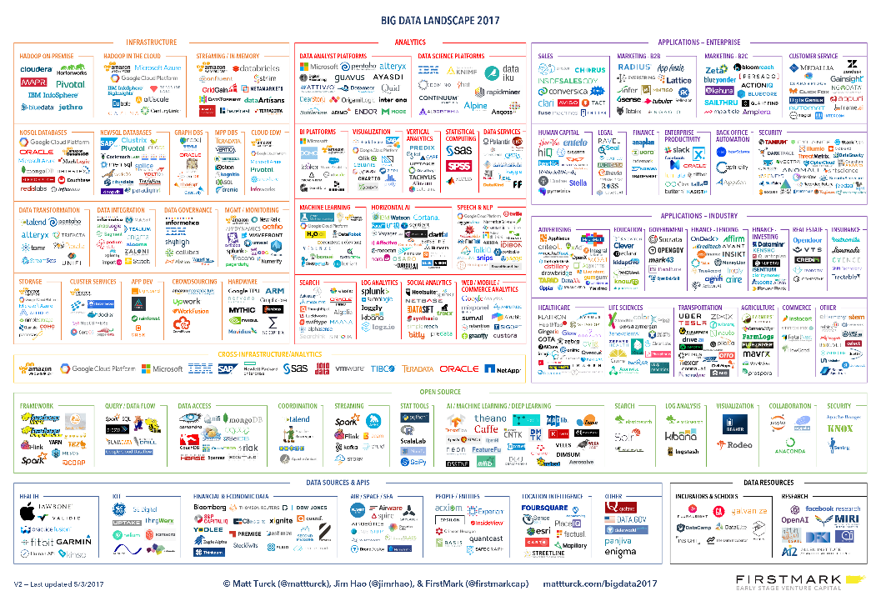
Landscape Completo Big Data
2017

Slide 12
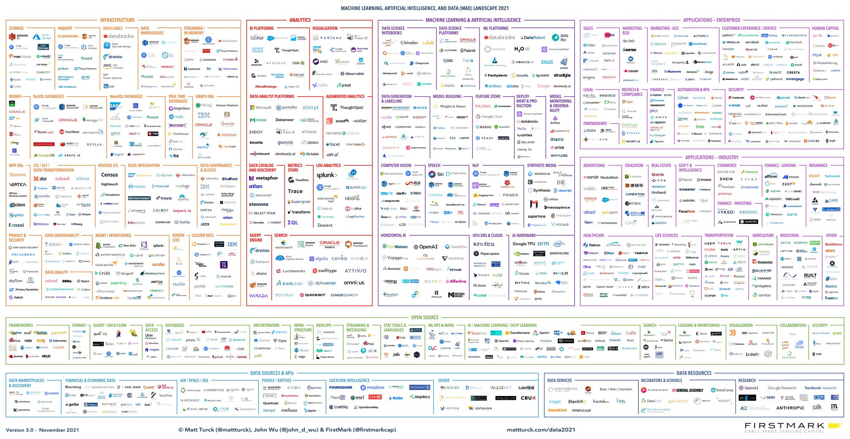

Landscape Completo Big Data (MAD) 2021
Notes:
Lisa y los dientes

Slide 13

Historia
Acceso a datos mediante Programas
Custom Programs and Punch Cards
Assembly
Fortran / C / Java
Acceso a Datos mediante SQL (Programmers & Business Users)
Relational Database (Transactional)
Notes:
The invention of computers created a clear need for information and data processing. During these very early days, computer scientists had to write custom programs for processing data and these were most likely stored on a punch card. The next steps brought assembly language and more purposeful programming languages like Fortran, followed by C and Java. During the prehistoric big data space, software engineers would use these languages to write purpose-built programs for specific data processing tasks. However, this data processing paradigm was only accessible to a select few that had a programming background which prevented wider adoption by data analysts or the wider business community who wanted to process information and make specific decisions.
The next natural step saw the invention of the database, in and around the 1970s. Traditional relational database systems, such as IBM’s databases, enabled SQL and increased the adoption of data processing by wider audiences. SQL is a standardised and expressive query language that reads somewhat like English. It allowed more people access to data processing who thereby no longer had to rely on programmers to write special case-by-case programs and analyse data. SQL also expanded the number and type of applications relevant to data processing such as business applications, analytics on churn rates, average basket size, year-on-year growth figures, etc.

Slide 14



En el inicio…
MAINFRAMES Y SISTEMAS OPERACIONALES
NECESIDAD DE ANALIZAR LO QUE PASÓ
PLATAFORMAS COSTOSAS
Notes:
Por que se creo un repositorio de informacion? Para que? Que paso ayer?

Slide 15
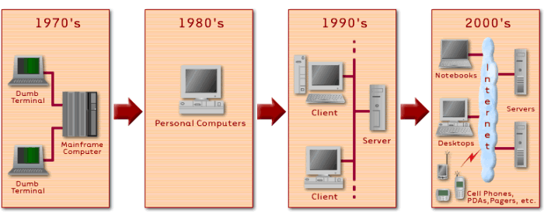
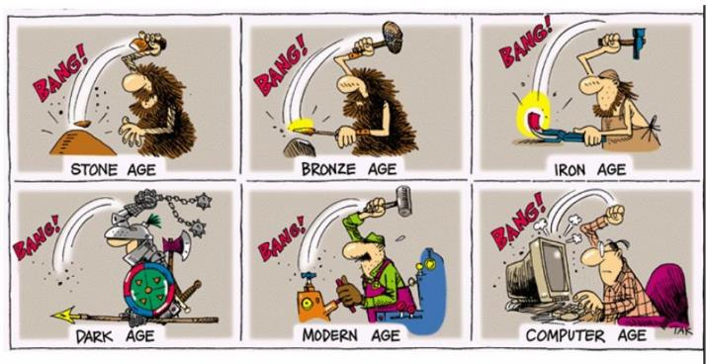
Evolución en los Sistemas de Información
Notes:
Evolución y todo sigue igual

Slide 16

Arquitecturas de Datos

Slide 17
Data Mart
“Base de datos departamental, especializada en el almacenamiento de los datos de un área de negocio específica. Se caracteriza por disponer la estructura óptima de datos para analizar la información al detalle desde todas las perspectivas que afecten a los procesos de dicho departamento.”
A data mart is the access layer of the data warehouse environment that is used to get data out to the users. The data mart is a subset of the data warehouse and is usually oriented to a specific business line or team. In some deployments, each department or business unit is considered the owner of its data mart including all the hardware, software and data.
Bill Inmod

Slide 18
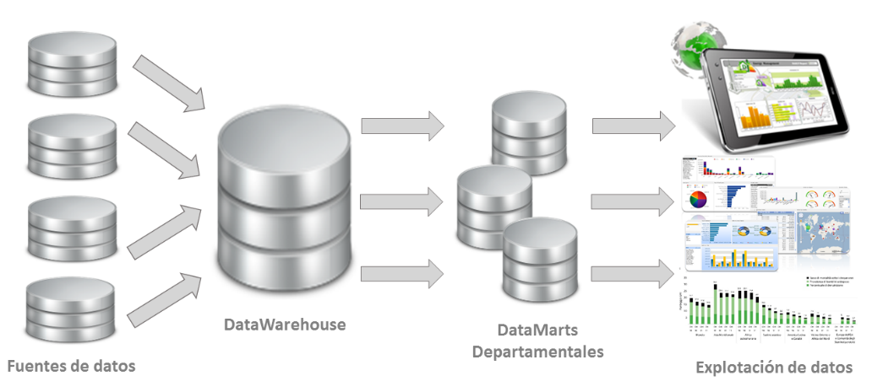
Estructura de un Datamart
Carga y Transformación
Notes:
Ventajas y desventajas

Slide 19

EL DATAWAREHOUSE
¿ACTUALIDAD O PARTE DE LA HISTORIA?

Slide 20
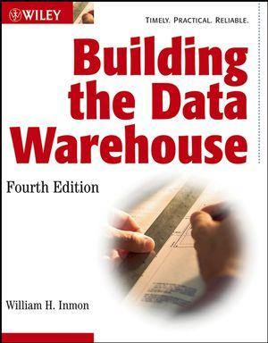
Notes:
1992. Building the Data Warehouse. 1st Edition. Wiley and Sons

Slide 21
Definición
“Colección de datos orientada a un determinado ámbito (empresa, organización, etc.), integrado, no volátil y variable en el tiempo, que ayuda a la toma de decisiones en la entidad en la que se utiliza”
A data warehouse is a subject-oriented, integrated, time-variant and non-volatile collection of data in support of management's decision-making process. Subject-Oriented: A data warehouse can be used to analyze a particular subject area.
Bill Inmon

Slide 22
OLTP vs OLAP
OLTP | ATRIBUTO | OLAP/DW
Transaccional | Necesidad del Negocio | Analítica
Simple | Query | Complejos
Actual | Temporalidad | Histórico
Conocidas | Preguntas del Negocio | Desconocidas
Estático | Entorno del Negocio | Dinámico

Slide 23

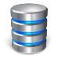

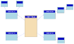

Capas Lógicas en la Arquitectura
Fuentes
(Capa1) Adquisición
Integración
(Capa 2)
Acceso
(Capa 3)
Entrega
ERP
Data Model
Applications
ODS
Datamart
Legacy
OLAP
Views
Carga
Transformaciones
Transformaciones
Dashboard
Files
In-Memory
Miners
Copias
ADS
Sandbox / Labs
(Capa 4)
Power User
Streams
Notes:
Que es cada punto.
Batch vs Stream.
Staging (copia de la info, poco espacio, traerse todo) vs ODS (algo de historia)
Modelo de Datos Integrado, normalizado, con reglas de calidad estrictas y representación de las reglas del negocio
Acceso. Multiples vistas sobre la información del DW. Múltiples copias o no. Visión por departamento. ADS. Cubos.
Capa de Entrega/Delivery. Cada herramienta que accesde, desde BI, SQL, Miners o Aplicaciones
Sandbox y el concepto de exploración y prueba, mezcla con info no productiva o externa. Promoción a Producción.

Slide 24




DataWarehouse
ETL/ELT (BATCH)
MODELO INTEGRADO
VISTAS SEMÁNTICAS
MARTS / SANDBOX

Slide 25
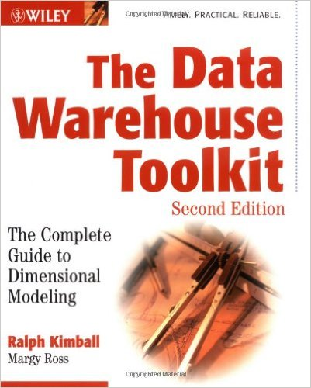

DIFERENTES ENFOQUES

Slide 26
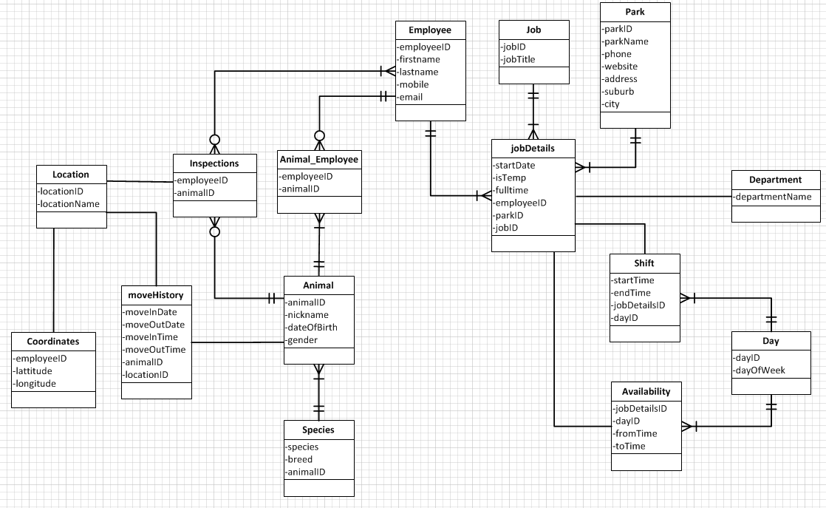
Inmon – Modelos Relacionales y 3NF
Representa las reglas del negocio
Independiente de la fuente del dato
Independiente de la aplicación
Independiente del uso final
Orientado a la integración

Slide 27
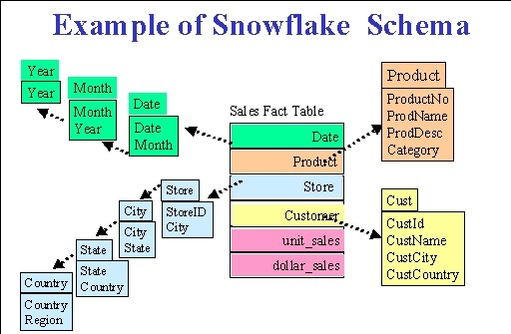
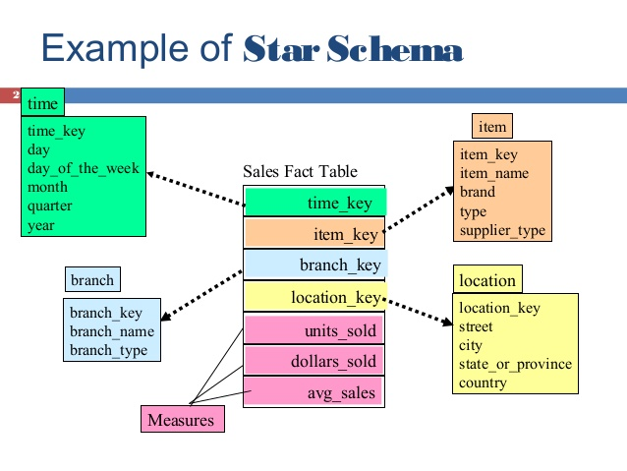
Esquema Estrella y Copo de Nieve

Slide 28
OTROS MODELOS DISPONIBLES
DATA VAULT
ANALYTIC DATA SET
ENTERPRISE FEATURE STORE

Slide 29
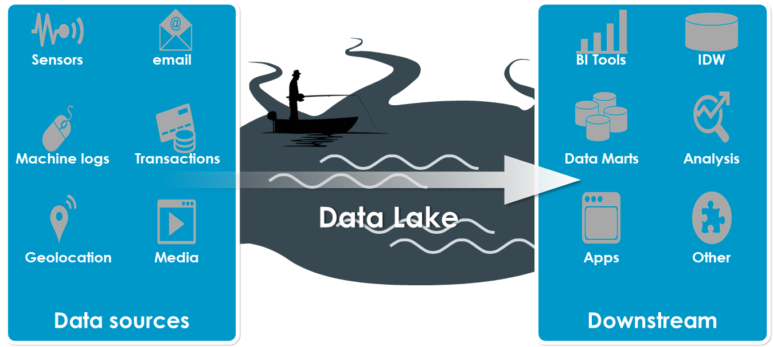
Data Lake
Un DataLake es una colección de datos “crudos” a largo plazo, almacenada haciendo uso especialmente de tecnologías de bajo costo de almacenamiento
Orientado a capturar, refinar y explorar los datos
Valor desconocido de antemano
Almacenamiento de datos con múltiples formatos (estructurados pero principalmente semi-estructurados o multi-estructurados)
CSV, XML, JSON, AVRO, etc.
El gobierno de los datos es un punto clave en la construcción de este tipo de arquitecturas
Sin un correcto catálogo nos encontramos ante un “pantano” y no un “lago”

Slide 30
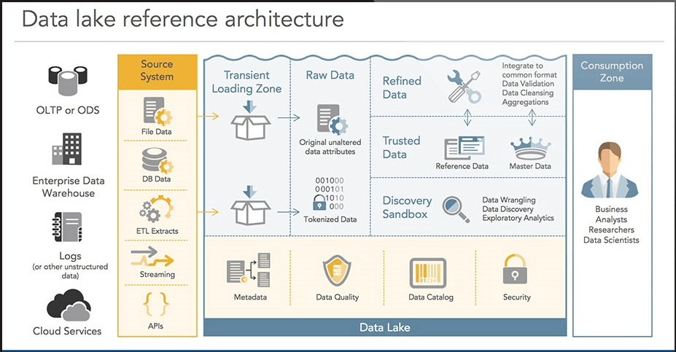
ARQUITECTURA

Slide 31


DataLake versus DataWarehouse
DTG
Data Lake Design Pattern
Data Warehouse Design Pattern
Escalable a bajo costo
Datos crudos (raw data)
Toneladas de datos
Datos exploratorios
Sin estructuras fijas
“Loosely coupled, late binding”
Orientado a programación
Poca concurrencia de usuarios
Pensado para performance
Integrado
Formatos consistentes
Datos no volátiles
Orientado a dominios
Modelos de Datos
Orientado a SQL
Altos niveles de concurrencia
≠

Slide 32


Slide 33
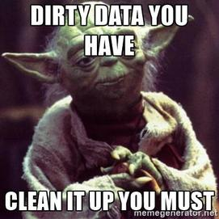

DATA ENGINEERS

Slide 34

ARQUITECTURAS (MÁS) MODERNAS
¿qué está pasando ahora?

Slide 35
CARACTERÍSTICAS DE UNA ARQUITECTURA MODERNA DE DATOS
Customer-Centric
Automatizada (AlgoOps)
Flexible y elástica
Colaborativa
Gobernada
Multi Nube / Híbrida
Monetizable
Segura
Resiliente
SIMPLE!!!!

Slide 36



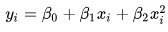
EFS – Enterprise Feature Store
Features (variables, características) creadas a través de procesamiento de los datos e ingeniería
Los Features aprobados se guardan en un repositorio global y centralizado para ser consumidos
Los siguientes modelos toman como base un Feature ya preparado, ahorrando tiempo y esfuerzo

Slide 37
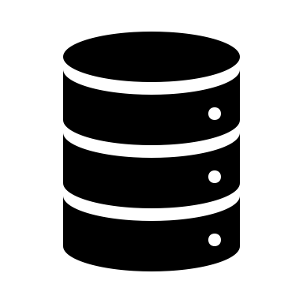
EFS – Flujo de un Feature Store
Model
Model
Model
Reuso de Features
Feature Store
Creación de los Features
Source Data

Slide 38
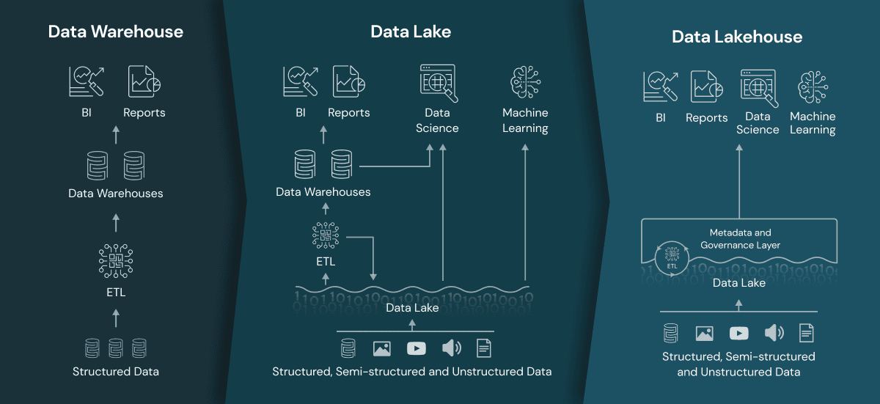
DATALAKEHOUSE

Slide 39
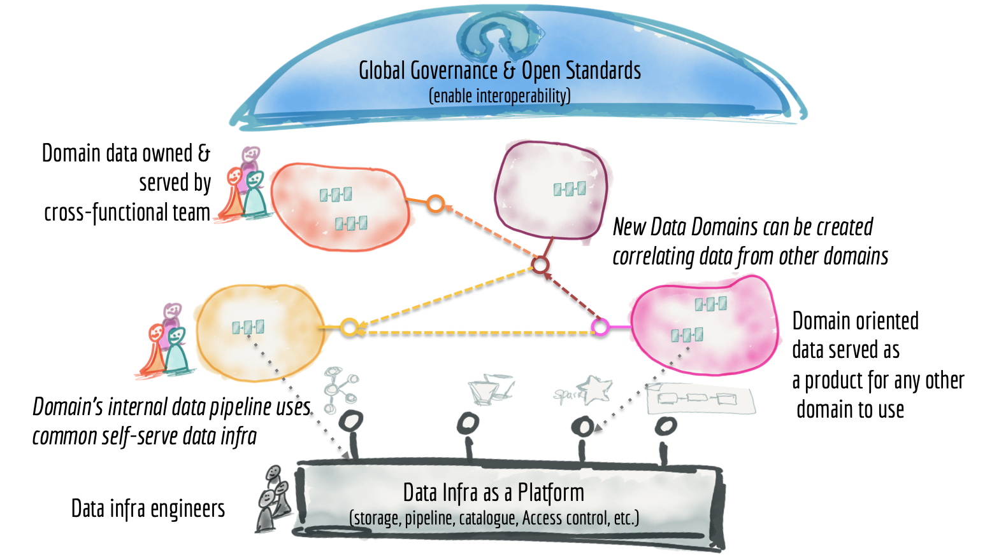
DATA MESH

Slide 40
SIEMPRE BUSCAR INICIATIVAS EN EL NEGOCIO
Iniciativas de Crecimiento de Revenue
Iniciativas de Reducción de Costos
Iniciativas de Regulación, Riesgos y Compliance

Slide 41


Slide 42
Big Data Architecture

Slide 43
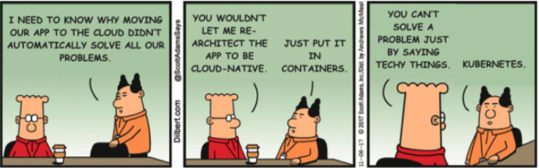
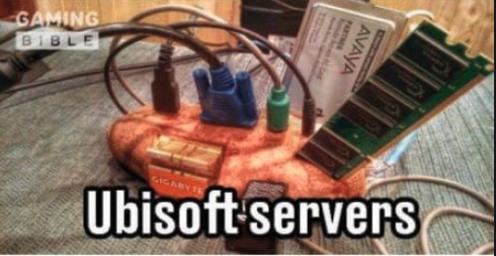
Qué es un servidor?
Brought to you
by
Notes:
Tipo de servidores
DNS
DHCP
File Servers
Directorios (LDAP)
Aplicaciones
Web

Slide 44
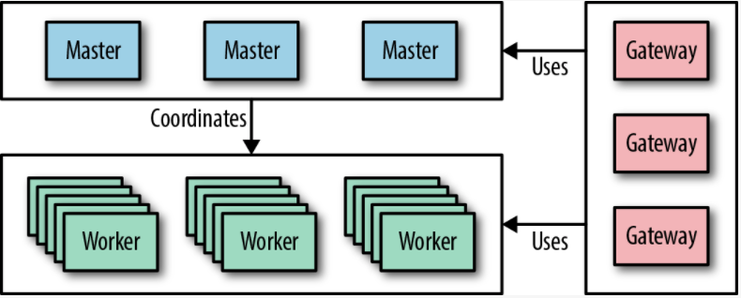
Clusters
Notes:
In the simplest sense, a cluster is just a bunch of servers grouped together to provide one or more functions, such as storage or computation. To users of a cluster, it is generally unimportant which individual machine or set of machines within the cluster performs a computation, stores the data, or performs some other service. By contrast, architects and administrators need to understand the cluster in detail.
Usually we divide a cluster up into two classes of machine: master and worker.
1 Worker machines are where the real work happens—these machines store data, perform computations, offer services like lookups and searches, and more.
Master machines are responsible for coordination, maintaining metadata about the data and services running on the worker machines, and ensuring the services keep running in the event of worker failures.
Typically, there are two or three master machines for redundancy and a much larger number of workers. A cluster is scaled up by adding more workers and, when the cluster gets large enough, extra masters.
Often, we want to allow access to the cluster by users and other applications, so we provide some machines to act as gateway or edge servers. These servers often do not run any services at all but just have the correct client configuration files to access cluster services.

Slide 45
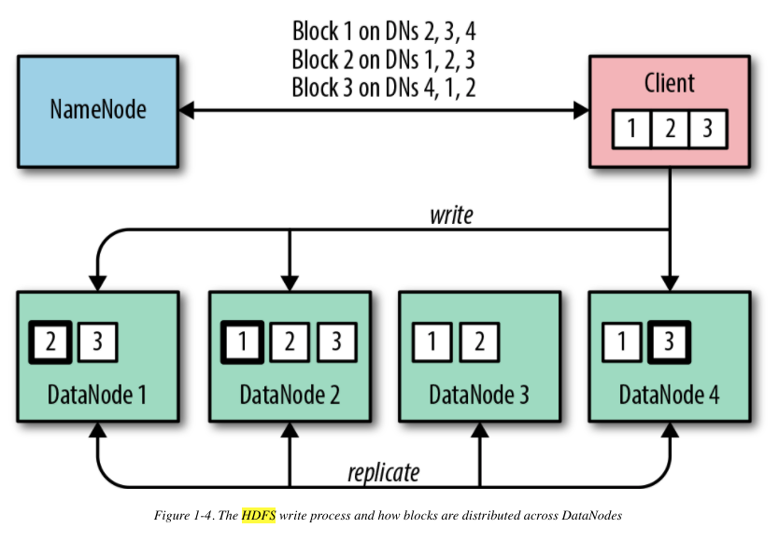
HDFS (Hadoop Distributed File System)
Notes:
The Hadoop Distributed File System (HDFS) is the scalable, fault-tolerant, and distributed filesystem for Hadoop. Based on the original use case of analytics over large-scale datasets, HDFS is optimized to store very large amounts of immutable data with files being typically accessed in long sequential scans. HDFS is the critical supporting technology for many of the other components in the stack.
When storing data, HDFS breaks up a file into blocks of configurable size, usually something like 128 MiB, and stores a replica of each block on multiple servers for resilience and data parallelism. Each worker node in the cluster runs a daemon called a DataNode which accepts new blocks and persists them to its local disks. The DataNode is also responsible for serving up data to clients. The DataNode is only aware of blocks and their IDs; it does not have knowledge about the file to which a particular replica belongs. This information is curated by a coordinating process, the NameNode, which runs on the master servers and is responsible for maintaining a mapping of files to the blocks, as well as metadata about the files themselves (things like names, permissions, attributes, and replication factor).
The design of HDFS means that it does not allow in-place updates to the files it stores. This can initially seem quite restrictive until you realize that this immutability allows it to achieve the required horizontal scalability and resilience in a relatively simple way.
HDFS is fault-tolerant because the failure of an individual disk, DataNode, or even rack does not imperil the safety of the data. In these situations, the NameNode simply directs one of the DataNodes that is maintaining a surviving replica to copy the block to another DataNode until the required replication factor is reasserted. Clients reading data are directed to one of the remaining replicas. As such, the whole system is self-healing, provided we allow sufficient capacity and redundancy in the cluster itself.
HDFS is scalable, given that we can simply increase the capacity of the filesystem by adding more DataNodes with local storage. This also has the nice side effect of increasing the available read and write throughput available to HDFS as a whole.
It is important to note, however, that HDFS does not achieve this resilience and scaling all on its own. We have to use the right servers and design the layout of our clusters to take advantage of the resilience and scalability features that HDFS offers—and in large part, that is what this book is all about.
In this short description of HDFS, we glossed over the fact that Hadoop abstracts much of this detail from the client. The API that a client uses is actually a Hadoop-compatible filesystem, of which HDFS is just one implementation.

Slide 46
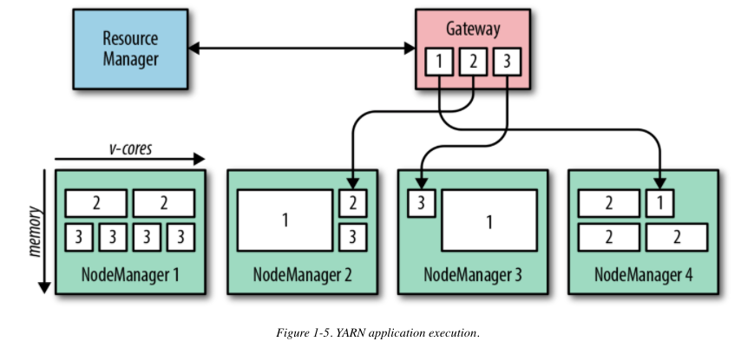
YARN (Yet Another Resource Negotiator)
Notes:
Although it’s useful to be able to store data in a scalable and resilient way, what we really want is to be able to derive insights from that data. To do so, we need to be able to compute things from the data, in a way that can scale to the volumes we expect to store in our Hadoop filesystem. What’s more, we need to be able to run lots of different computations at the same time, making efficient use of the available resources across the cluster and minimizing the required effort to access the data. Each computation processes different volumes of data and requires different amounts of compute power and memory. To manage these competing demands, we need a centralized cluster manager, which is aware of all the available compute resources and the current competing workload demands.
This is exactly what YARN (Yet Another Resource Negotiator) is designed to be. YARN runs a daemon on each worker node, called a NodeManager, which reports in to a master process, called the ResourceManager. Each NodeManager tells the ResourceManager how much compute resource (in the form of virtual cores, or vcores) and how much memory is available on its node. Resources are parceled out to applications running on the cluster in the form of containers, each of which has a defined resource demand—say, 10 containers each with 4 vcores and 8 GB of RAM. The NodeManagers are responsible for starting and monitoring containers on their local nodes and for killing them if they exceed their stated resource allocations.

Slide 47
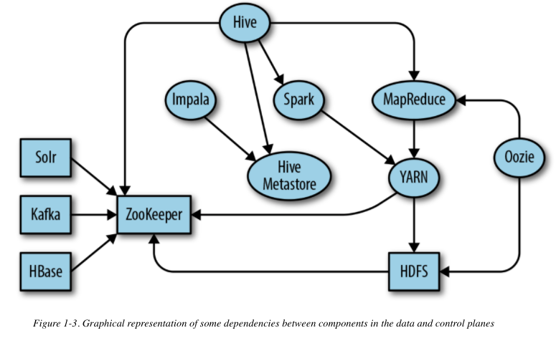
APACHE ZOOKEEPER
Notes:
The problem of consensus is an important topic in computer science. When an application is distributed across many nodes, a key concern is getting these disparate components to agree on the values of some shared parameters. For example, for frameworks with multiple master processes, agreeing on which process should be the active master and which should be in standby is critical to their correct operation.
Apache ZooKeeper is the resilient, distributed configuration service for the Hadoop ecosystem. Within ZooKeeper, configuration data is stored and accessed in a filesystem-like tree of nodes, called znodes, each of which can hold data and be the parent of zero or more child nodes. Clients open a connection to a single ZooKeeper server to create, read, update and delete the znodes.

Slide 48
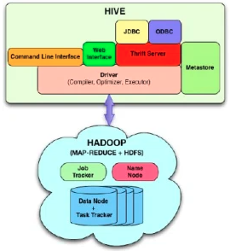
APACHE HIVE METASTORE
Notes:
The Hive Metastore curates information about the structured datasets (as opposed to unstructured binary data) that reside in Hadoop and organizes them into a logical hierarchy of databases, tables, and views. Hive tables have defined schemas, which are specified during table creation. These tables support most of the common data types that you know from the relational database world. The underlying data in the storage engine is expected to match this schema, but for HDFS this is checked only at runtime, a concept commonly referred to as schema on read. Hive tables can be defined for data in a number of storage engines, including Apache HBase and Apache Kudu, but by far the most common location is HDFS.
In HDFS, Hive tables are nothing more than directories containing files. For large tables, Hive supports partitioning via subdirectories within the table directory, which can in turn contain nested partitions, if necessary. Within a single partition, or in an unpartitioned table, all files should be stored in the same format; for example, comma-delimited text files or a binary format like Parquet or ORC. The metastore allows tables to be defined as either managed or external. For managed tables, Hive actively controls the data in the storage engine: if a table is created, Hive builds the structures in the storage engine, for example by making directories on HDFS. If a table is dropped, Hive deletes the data from the storage engine. For external tables, Hive makes no modifications to the underlying storage engine in response to metadata changes, but merely maintains the metadata for the table in its database.
Other projects, such as Apache Impala and Apache Spark, rely on the Hive Metastore as the single source of truth for metadata about structured datasets within the cluster. As such it is a critical component in any deployment.

Slide 49
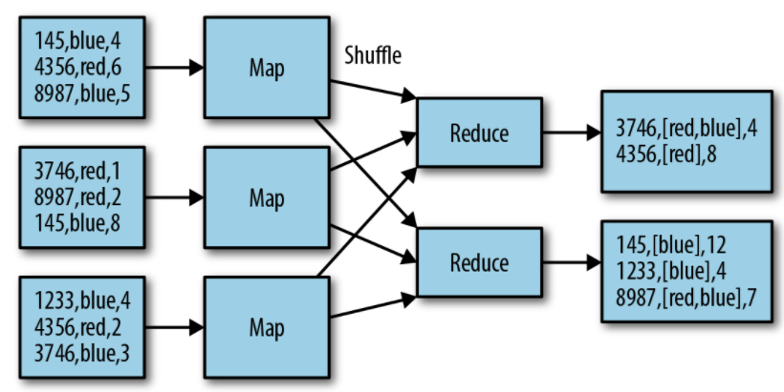
MapReduce
Notes:
El Framework MapReduce tiene una arquitectura maestro / esclavo. Cuenta con un servidor maestro o JobTracker y varios workers o TaskTrackers, uno por cada nodo del clúster.
El JobTracker es el punto de interacción entre los usuarios y el framework MapReduce. Los usuarios envían trabajos MapReduce al JobTracker, que los pone en una cola de trabajos pendientes y los ejecuta en el orden de llegada. El JobTracker gestiona la asignación de tareas y delega las tareas a los TaskTrackers. Los TaskTrackers ejecutan tareas bajo la orden del JobTracker y también manejan el movimiento de datos entre la fase Map y Reduce.
Essentially, MapReduce divides a computation into three sequential stages: map, shuffle, and reduce. In the map phase, the relevant data is read from HDFS and processed in parallel by multiple independent map tasks. These tasks should ideally run wherever the data is located—usually we aim for one map task per HDFS block. The user defines a map() function (in code) that processes each record in the file and produces key-value outputs ready for the next phase. In the shuffle phase, the map outputs are fetched by MapReduce and shipped across the network to form input to the reduce tasks. A user-defined reduce() function receives all the values for a key in turn and aggregates or combines them into fewer values which summarize the inputs.
Sequences of these three simple linear stages can be composed and combined into essentially any computation of arbitrary complexity; for example, advanced transformations, joins, aggregations, and more. Sometimes, for simple transforms that do not require aggregations, the reduce phase is not required at all. Usually, the outputs from a MapReduce job are stored back into HDFS, where they may form the inputs to other jobs.
Despite its simplicity, MapReduce is incredibly powerful and extremely robust and scalable. It does have a couple of drawbacks, though. First, it is quite involved from the point of view of a user, who needs to code and compile map() and reduce() functions in Java, which is too high a bar for many analysts—composing complex processing pipelines in MapReduce can be a daunting task. Second, MapReduce itself is not particularly efficient. It does a lot of disk-based I/O, which can be expensive when combining processing stages together or doing iterative operations. Multistage pipelines are composed from individual MapReduce jobs with an HDFS I/O barrier in between, with no recognition of potential optimizations in the whole processing graph.
Because of these drawbacks, a number of successors to MapReduce have been developed that aim both to simplify development and to make processing pipelines more efficient. Despite this, the conceptual underpinnings of MapReduce—that data processing should be split up into multiple independent tasks running on different machines (maps), the results of which are then shuffled to and grouped and collated together on another set of machines (reduces)—are fundamental to all distributed data processing engines, including SQL-based frameworks. Apache Spark, Apache Flink, and Apache Impala, although all quite different in their specifics, are all essentially different implementations of this concept.

Slide 50
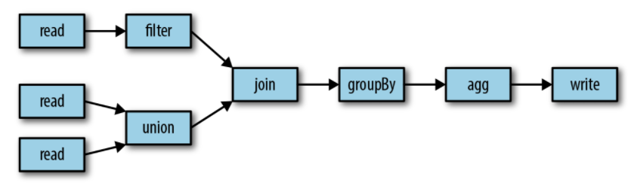
Apache Spark
Notes:
Apache Spark is a distributed computation framework, with an emphasis on efficiency and usability, which supports both batch and streaming computations. Instead of the user having to express the necessary data manipulations in terms of pure map() and reduce() functions as in MapReduce, Spark exposes a rich API of common operations, such as filtering, joining, grouping, and aggregations directly on Datasets, which comprise rows all adhering to a particular type or schema. As well as using API methods, users can submit operations directly using a SQL-style dialect (hence the general name of this set of features, Spark SQL), removing much of the requirement to compose pipelines programmatically. With its API, Spark makes the job of composing complex processing pipelines much more tractable to the user.
One of the principal design goals for Spark was to take full advantage of the memory on worker nodes, which is available in increasing quantities on commodity servers. The ability to store and retrieve data from main memory at speeds which are orders of magnitude faster than those of spinning disks makes certain workloads radically more efficient. Distributed machine learning workloads in particular, which often operate on the same datasets in an iterative fashion, can see huge benefits in runtimes over the equivalent MapReduce execution. Spark allows datasets to be cached in memory on the executors; if the data does not fit entirely into memory, the partitions that cannot be cached are spilled to disk or transparently recomputed at runtime.
Spark implements stream processing as a series of periodic microbatches of datasets. This approach requires only minor code differences in the transformations and actions applied to the data—essentially, the same or very similar code can be used in both batch and streaming modes. One drawback of the micro-batching approach is that it takes at least the interval between batches for an event to be processed, so it is not suitable for use cases requiring millisecond latencies. However, this potential weakness is also a strength because microbatching allows much greater data throughput than can be achieved when processing events one by one. In general, there are relatively few streaming use cases that genuinely require subsecond response times. However, Spark’s structured streaming functionality promises to bring many of the advantages of an optimized Spark batch computation graph to a streaming context, as well as a low-latency continuous streaming mode.

Slide 51
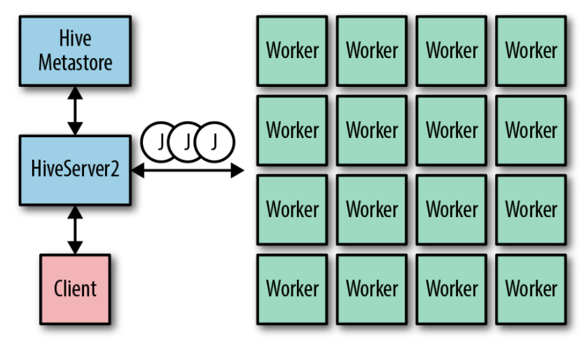
APACHE HIVE
Notes:
Although MapReduce and Spark are extremely flexible and powerful frameworks, to use them you do need to be comfortable programming in a language like Java, Scala, or Python and should be happy deploying and running code from the command line. The reality is that, in most enterprises, SQL remains the lingua franca of analytics, and the largest, most accessible skill base lies there.
Apache Hive is the original data warehousing technology for Hadoop. It was developed at Facebook and was the first to offer a SQL-like language, called HiveQL, to allow analysts to query structured data stored in HDFS without having to first compile and deploy code. Hive supports common SQL query concepts, like table joins, unions, subqueries, and views. At a high level, Hive parses a user query, optimizes it, and compiles it into one or more chained batch computations, which it runs on the cluster. Typically these computations are executed as MapReduce jobs, but Hive can also use Apache Tez and Spark as its backing execution engine. Hive has two main components: a metadata server and a query server. We covered the Hive Metastore earlier, so we focus on the querying functionality in this section.
Users who want to run SQL queries do so via the query server, called HiveServer2 (HS2). Users open sessions with the query server and submit queries in the HQL dialect. Hive parses these queries, optimizes them as much as possible, and compiles them into one or more batch jobs. Queries containing subqueries get compiled into multistage jobs, with intermediate data from each stage stored in a temporary location on HDFS. HS2 supports multiple concurrent user sessions and ensures consistency via shared or exclusive locks in ZooKeeper. The query parser and compiler uses a cost-based optimizer to build a query plan and can use table and column statistics (which are also stored in the metastore) to choose the right strategy when joining tables. Hive can read a multitude of file formats through its built-in serialization and deserialization libraries (called SerDes) and can also be extended with custom formats.

Slide 52
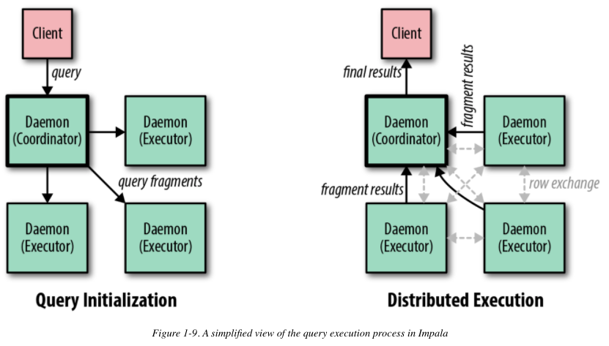
APACHE IMPALA
Notes:
Apache Impala is a massively parallel processing (MPP) engine designed to support fast, interactive SQL queries on massive datasets in Hadoop or cloud storage. Its key design goal is to enable multiple concurrent, ad hoc, reporting-style queries covering terabytes of data to complete within a few seconds. It is squarely aimed at supporting analysts who wish to execute their own SQL queries, directly or via UI-driven business intelligence (BI) tools.
In contrast to Hive or Spark SQL, Impala does not convert queries into batch jobs to run under YARN. Instead it is a standalone service, implemented in C++, with its own worker processes which run queries, the Impala daemons. Unlike with Hive, there is no centralized query server; each Impala daemon can accept user queries and acts as the coordinator node for the query.

Slide 53
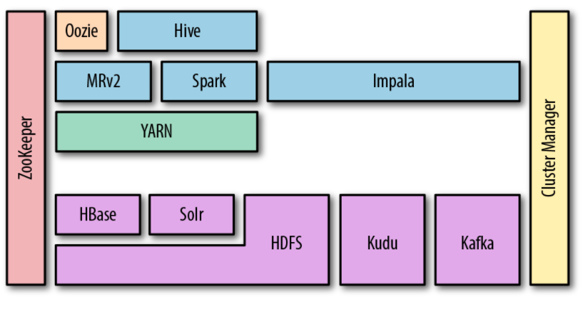


Big Data Architecture
Notes:
Apache Oozie is the job scheduling and execution framework for Hadoop. The basic units of execution within Oozie jobs are actions, which represent tasks that run in the Hadoop ecosystem, such as Hive queries or MapReduce jobs. Actions are composed into workflows, which represent logical sequences or orderings of tasks that need to be run together. Workflows can be run to a schedule via coordinators, which in turn can be grouped together into bundles for logical grouping of applications. An Oozie job can refer to a workflow, coordinator, or bundle.
Kudu is a structured data store which stores rows with typed columns in tables with a predefined schema. A subset of the columns is designated as the primary key for the table and forms an index into the table by which Kudu can perform row lookups. Kudu supports the following write operations: insert, update, upsert (insert if the row doesn’t exist, or update if it does), and delete. On the read side, clients can construct a scan with column projections and filter rows by predicates based on column values.
Kudu distributes tables across the cluster through horizontal partitioning. A table is broken up into tablets through one of two partitioning mechanisms, or a combination of both. A row can be in only one tablet, and within each tablet, Kudu maintains a sorted index of the primary key columns. The first partitioning mechanism is range partitioning and should be familiar to users of HBase and Accumulo. Each tablet has an upper and lower bound within the range, and all rows with partition keys that sort within the range belong to the tablet.
The desire by some early web companies to store tens of billions to trillions of records and to allow their efficient retrieval and update led to the development of Apache HBase—a semi-structured, random-access key-value store using HDFS as its persistent store. As with many of the Hadoop projects, the original blueprint for the framework came from a paper published by Google describing its system Bigtable. Essentially, HBase provides a means by which a random-access read/write workload (which is very inefficient for HDFS) is converted to sequential I/O (which HDFS excels at).
Sometimes SQL is not enough. Some applications need the ability to perform more flexible searches on unstructured or semi-structured data. Many use cases, such as log search, document vaults, and cybersecurity analysis, can involve retrieving data via free-text search, fuzzy search, faceted search, phoneme matching, synonym matching, geospatial search, and more. For these requirements, often termed enterprise search, we need the ability to automatically process, analyze, index, and query billions of documents and hundreds of terabytes of data. There are two primary technologies in the ecosystem at present: Apache Solr and Elasticsearch.
One of the primary drivers behind a cluster is to have a single platform that can store and process data from a multitude of sources. The sources of data within an enterprise are many and varied: web logs, machine logs, business events, transactional data, text documents, images, and more. This data arrives via a multitude of modes, including push-based, pull-based, batches, and streams, and in a wide range of protocols: HTTP, SCP/SFTP, JDBC, AMQP, JMS, and more. Within the platform ecosystem, there are multiple sinks for incoming data: HDFS, HBase, Elasticsearch, and Kudu, to name but a few. Managing and orchestrating the ingestion into the platform in all these modes can quickly become a design and operational nightmare.
Apache Kafka is a publish/subscribe system designed to be horizontally scalable in both volume and client read and write bandwidth. Its central idea is to use distributed, sequential logs as the storage mechanism for incoming messages and to allow clients, or groups of clients, to consume data from a given point using simple numerical offsets. Kafka has become a critical glue technology, providing a resilient and highly available ingestion buffer, which integrates multiple upstream sources and downstream sinks. Increasingly, stream processing and stateful querying of streams is supported within the Kafka ecosystem itself, with Kafka operating as the system of record.
The fundamental data structure in Kafka is the topic, which is a sequence of messages (or records) distributed over multiple servers (or brokers). Each topic can be created with multiple partitions, each of which is backed by an on-disk log. For resilience, partitions have multiple replicas residing on different brokers.
Kafka can be used in many ways. Most commonly, it is used as a scalable buffer for data streaming to and from storage engines on Hadoop. It is also frequently used as a data interchange bus in flexible stream processing chains.

Slide 54

Gracias!

